Slide 1

Internship Report-18ECP112L
Name-Rohit Kumar Mohanty
Register No-RA1911004010259
Department/Section - ECE/E
College-SRM Institute of Science and Technology
Campus - Kattankulathur

Slide 2
Index
Presentation Outline
About The Organization
Description about internship
Certificate
Title of Project
Brief About Experience Gained
Conclusion

Slide 3
Presentation Outline
I have been part of the R&D team as Embedded Engineer and worked on IOT projects.IOT Based Scanner using Bluetooth Low Energy (BLE) capable devices with user devices is neither secure nor trivial. Secure pairing and identification of BLE devices is described.
Automatic number-plate recognition (ANPR) is a technology that uses optical Character Recognition on images to read vehicles registration plate to create Vehicle Location Data.

Slide 4
About The Organization
I completed my internship with Kriti Labs in Chennai, which offers a platform for learning the fundamentals and applying concepts to real-world issues. I spent three months working as an intern. Regarding the company's objective, vision, and purpose
Mission: To provide solutions in areas of security, process enforcement and compliance management to different industries thereby helping them to improve the productivity of their assets.
Vision: Add value in every human endeavor that is limited either by geography or process complexity.
Purpose: Value addition through digital transformation.

Slide 5
Description about Internship
I have worked on ESP32 and BLE Scanner. Worked on file transfer and the team is very helpful and they helped me out in every point of time. QR and Barcode scanner solves this issue by saving all data in a QR / Bar code.
I have worked on ANPR on Data annotation and data cleaning. This annotated data is then used for model training. Data annotation is the process of labeling individual elements of training data (whether text,images, audio, or video) to help machines understand what exactly is in it and what is important.

Slide 6
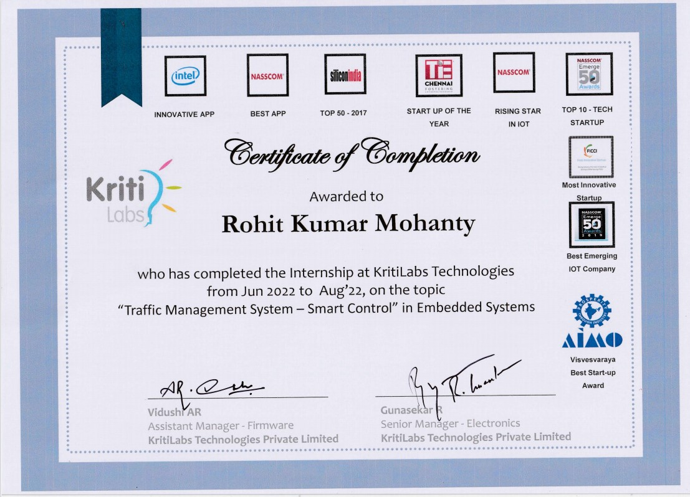
Certificate

Slide 7
IOT Based QR and Barcode Scanner
IOT Based Scanner using Bluetooth Low Energy (BLE) capable devices with user devices is neither secure nor trivial. Secure pairing and identification of BLE devices is described. A service (e.g., web service) provides a list of unique identifiers (UIDs) and an encrypted UID to a BLE device without a decryption key. Each BLE device with a UID generated by the service. It also generates a quick response (QR) code to print on the BLE device. To pair with the BLE device, a user uses a camera or other scanner of the end-user device to simply scan the QR code.
The option, people would prefer clicking a picture instead of typing things out manually. The documents can be scanned on a mobile device, which helps in the easy transmission of data. However, a scan is merely an image capture of the original document, so it cannot be easily broadcasted or transmitted to other people. This results in a decrease in public attention as the information is not able to reach its intended crowd. QR and Barcode scanner solves this issue by saving all data in a QR / Bar code.

Slide 8
IOT Based QR and Barcode Scanner
The ESP32 is used to connect to a wireless network, and the scanner module is used to deliver the scanned data to an AWS server.
Each Product ID scan will have a unique sequence ID.
Scanner module has been installed with a ESP 32 in U-art mode
It is not possible to bring the products and scan. Wired scanner to pull and scan it individually.
With using the Bluetooth Low Energy (BLE) and scanner model we can scan it from any corner and get it on the Cloud platform.
Implementation at the production house of the company and checked the updates on Cloud platform.
File Transfer over BLE

Slide 9
AUTOMATIC NUMBER PLATE RECOGNIZATION
Automatic number-plate recognition (ANPR) is a technology that uses optical character recognition on images to read vehicle registration plates to create vehicle location data . It can use existing closed-circuit television , road-rule enforcement cameras , or cameras specifically designed for the task. ANPR is used by police forces around the world for law enforcement purposes, including to check if a vehicle is registered or licensed . It is also used for electronic toll collection on pay-per-use roads and as a method of cataloguing the movements of traffic by highways agencies.
Automatic number-plate recognition can be used to store the images captured by the cameras as well as the text from the license plate, with some configurable to store a photograph of the driver. Systems commonly use infrared lighting to allow the camera to take the picture at any time of day or night.

Slide 10
AUTOMATIC NUMBER PLATE RECOGNIZATION
DATA ANNOTATION:
Data annotation is the process of labeling individual elements of training data (whether text,images, audio, or video) to help machines understand what exactly is in it and what is important.
This annotated data is then used for model training.
Data annotation also plays a part in the larger quality control process of data collection, as well—annotated datasets become ground truth datasets: data that is held up as a gold standard and used to measure model performance and the quality of other datasets.

Slide 11
AUTOMATIC NUMBER PLATE RECOGNIZATION
DATA CLEANING:
Data cleaning is the process of fixing or removing incorrect, corrupted, incorrectly formatted,duplicate, or incomplete data within a dataset.
When combining multiple data sources, there are many opportunities for data to be duplicated or mislabeled.
If data is incorrect, outcomes and algorithms are unreliable, even though they may look correct.

Slide 12
Components Used
Arduino IDE
QR Module Command Set
AWS Management Console

Slide 13
Experience Gain
This internship helped me to grow professionally and personally. On professional front I learned many technical skills like in Data Annotation, implementation of Arduino IDE, Data Cleaning and core knowledge. This internship provided me a new learning opportunity in field of technology.

Slide 14
Conclusion
Hence I have implemented the my idea using Arduino IDE and ANPR successfully with the help of my Guide who have keep encouraging and Implementing new Ideas. I have successfully completed my Internship with their guidance.

Slide 15
THANK YOU

